Slide 1
SEMANTIC DISTINGUISHING TO IDENTIFY THE CONTEXT OF A WORD IN TELUGU SENTENCES
Mentor – Dr.M.V.Vijaya Saradhi
K Neha -18AG1A0521
P Shivani -18AG1A0545
M Indu -18AG1A0534
S Arjun -18AG1A0551
N Nirmala -19AG5A0505

Slide 2
ABSTRACT
Word Sense Disambiguation (WSD) is the problem of determining which "sense" (meaning) of a word is activated by the use of the word in a particular context. Up until now, this has been largely performed on sentences in the English language to identify the sense or context of a word in that sentence. This project implements it for regional languages as well , specifically , Telugu. Since, Telugu vocabulary is huge, occurrences of ambiguity is common and this project is aimed at resolving them. To achieve this, Knowledge based algorithm is used which includes finding the overlap between the features of different senses of an ambiguous word and the features of the words in its context.

Slide 3
INTRODUCTION
Word Sense Disambiguation (WSD) is the task of automatically identifying the appropriate sense of an ambiguous word based on the context in which the word is used. For example, the term cold could refer to the temperature or the common cold, depending on how the word is used in the sentence.
Example in telugu : “paamu ni karra tho kottu”, “battala kottu” . Here the “kottu” word has different meaning in the above two sentence.
Automatically identifying the intended sense of ambiguous words improves the performance of biomedical and clinical applications such as medical coding and indexing; applications that are becoming essential tasks due to the growing amount of information available to researchers.

Slide 4
Literature Survey
“A Study of Critical Approaches in WSD for Telugu Language Nouns: Current State of the Art”
Authors: J. Sreedhar , Dr. S. Viswanadha Raju, Dr. A. Vinaya Babu
The merits in this paper is that it gives an overview of the work that has been done in the field of Natural Language Processing (NLP) and more specifically in Word Sense Disambiguation, which is a subset of NLP. All of these different methods have been taken from various research papers and presented in concise manner such that a person interested in working on Word Sense Disambiguation can get a clear idea of how to proceed.
Even though the paper discusses various methods for Word Sense Disambiguation, it doesn’t provide any implementation details about it. Lesk has been chosen to perform WSD in this project as it has not been researched extensively for Telugu, unlike other algorithms.
Many methods were analysed in this paper and provided a concise explanation. Since no implementation details were provided, this project aims at implementing Lesk algorithm described in the paper

Slide 5
“pyiwn: A Python-based API to access Indian Language WordNets”
Authors: Ritesh Panjwani, Diptesh Kanojia, Pushpak Bhattacharyya
The paper provides a detailed description of how the pyiwn project was built, its motivation, procedure and utilisation procedures. It also gives examples of its usage. It being a python module, it is easier to integrate into projects as it doesn’t require additional overhead.
The paper provides details about the pyiwn project but not its implementation in Word Sense Disambiguation. This project uses the python module described in the paper and implements it to achieve Word Sense Disambiguation for Telugu. Since it provides an API to access Telugu IndoWordNet along with other languages, this paper was chosen for this project’s implementation.
Finally, by implementing the ‘pyiwn’ module from the paper , which stands for ‘Python Indo Word Net’, this project aims to achieve Word Sense Disambiguation for Telugu.

Slide 6
EXISTING SYSTEM
Almost all word sense disambiguation focus on English and English synsets. Theme or context finding is an important part in processes such as page ranking and very few systems exist that perform word sense disambiguation in telugu.

Slide 7
PROPOSED SYSTEM
Our solutions aims at performing word sense disambiguation on telugu sentences to help gauge the theme of the sentence.
It gives example for each word in the searched sentence in telugu with same sense(meaning in the sentence).
The tools and packages used are:
Python
Pyiwn package - to access telugu synset
Nltk package - to access Natural Language parsing tools
Algorithm – Lesk algorithm

Slide 8
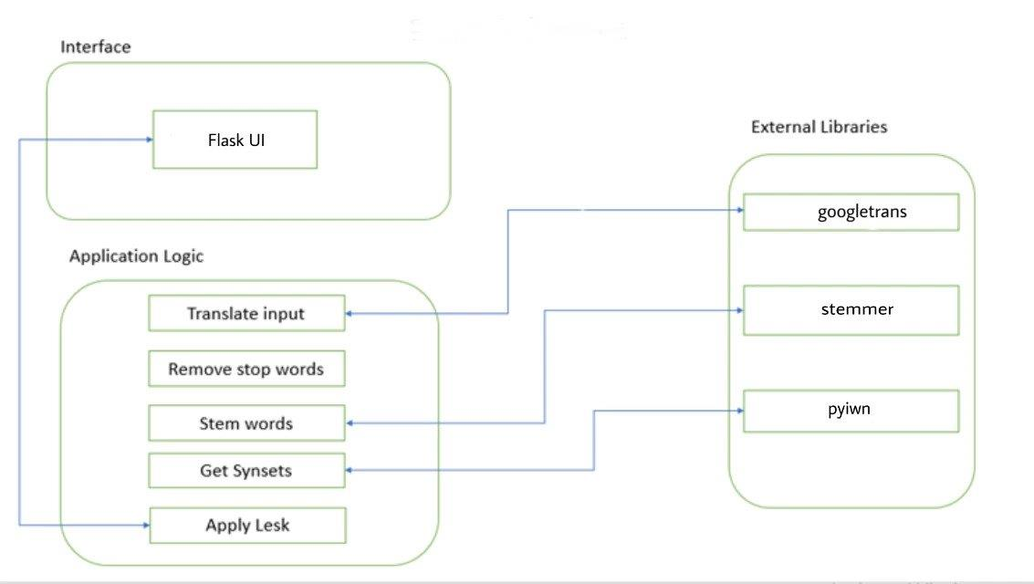
System Architecture
OUTPUT

Slide 9
LESK
The Lesk algorithm is a classical word sense disambiguation algorithm introduced by Michael E. Lesk.
It is based on the assumption that the sense of a word is dependent upon the words present in its neighborhood. More specifically, sense or context of a word is determined by comparing the meaning of each sense of the word with the meanings of the neighboring words. This comparison is made by matching the words in meanings and the sense whose meaning matches the maximum number of times is taken as the resultant sense of that particular word in a given sentence

Slide 10
Steps in Lesk Algorithm:
Consider a word for processing.
Next, take the remaining words and create a list of words which consist of the gloss and examples of those words. Let’s call it ‘matcher_list’.
Remove stop words from these lists to reduce irregular matches
Now for every synset of the word to be processed, create a similar list of words containing the gloss and examples of that synset. Let’s call this list ‘synset_list’
Match the above two list to find overlap of words.
The synset_list which has the maximum overlap with the matcher_list is taken as the best synset and the gloss of the synset is taken as the best sense.

Slide 11
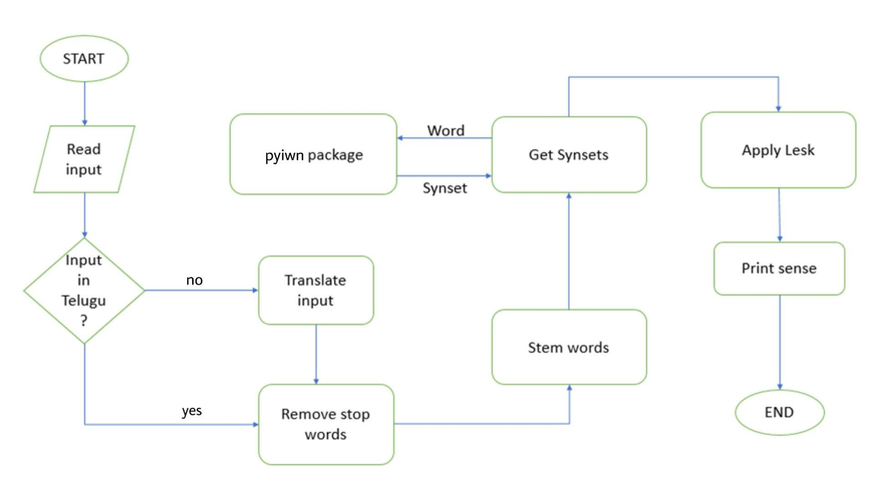
Flow chart

Slide 12
System Requirements
Software Requirement :
Operating System: Linux/Windows/Mac
Language used: Python
Hardware requirements :
Processor: intel CORE i5
Speed: 1.6GHz
RAM: 4GB

Slide 13
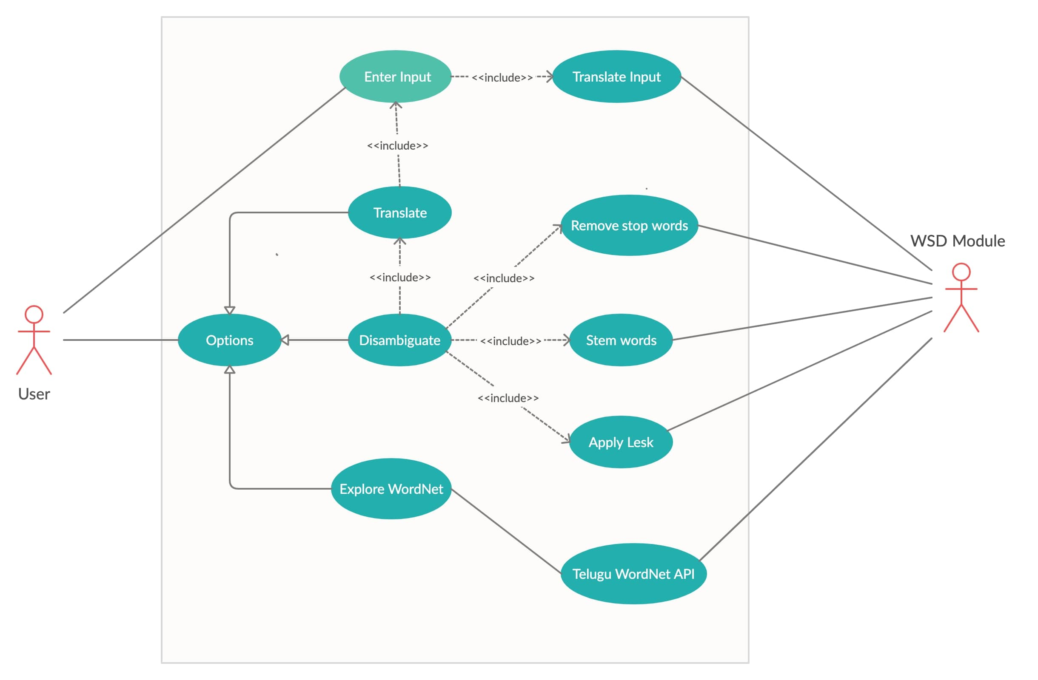
UML Diagrams
USE CASE Diagram

Slide 14
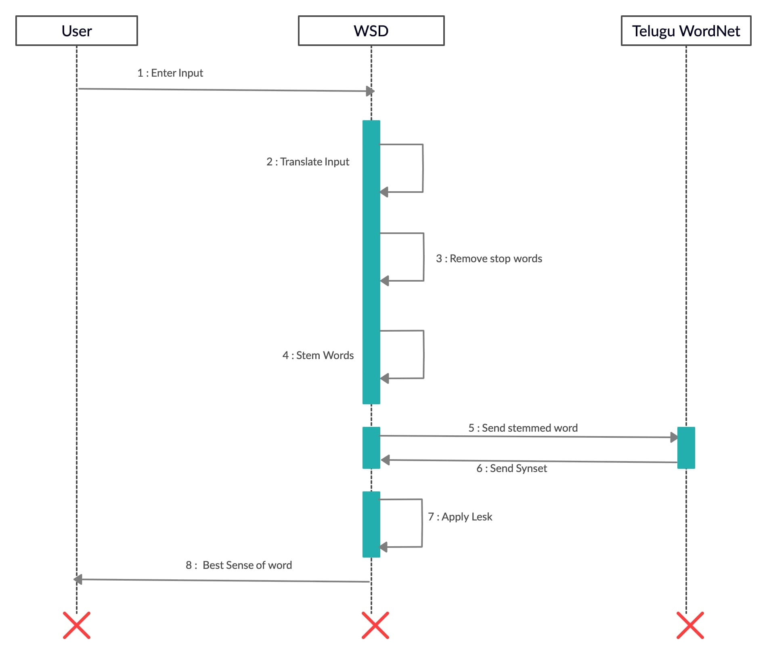
Sequence Diagram

Slide 15
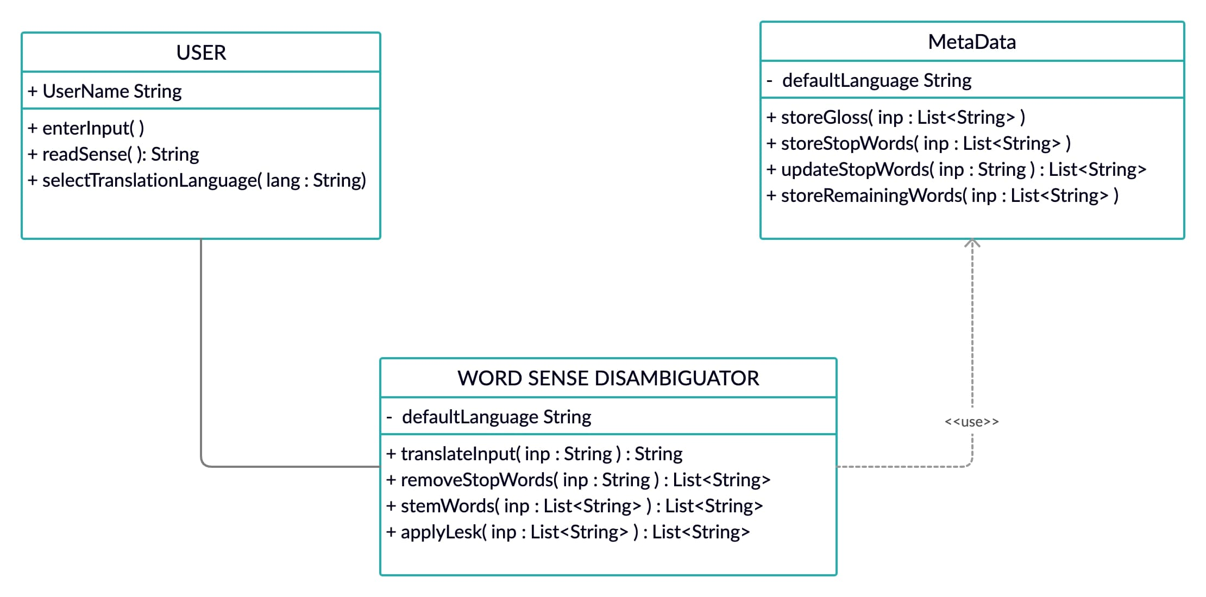
Class Diagram

Slide 16
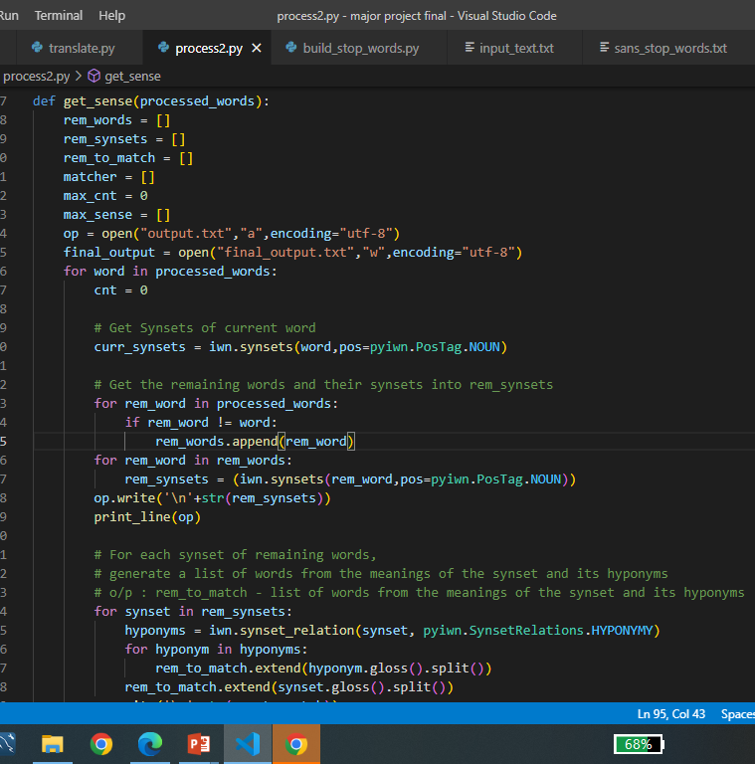
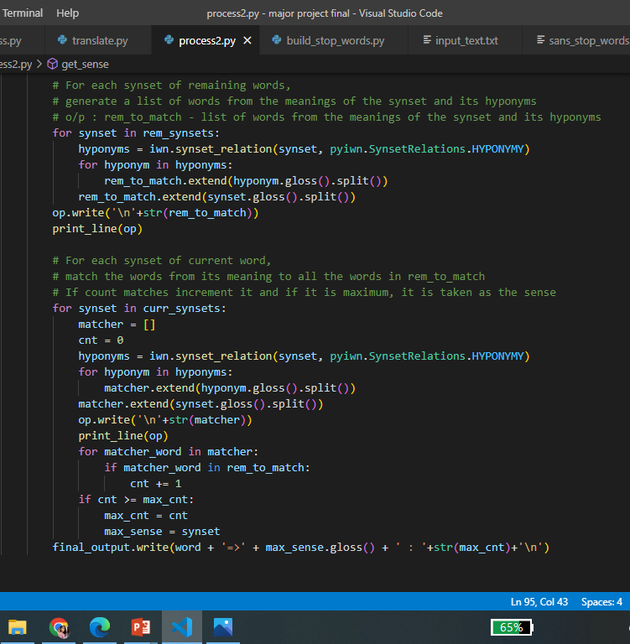
SAMPLE CODE: Getting sense

Slide 17
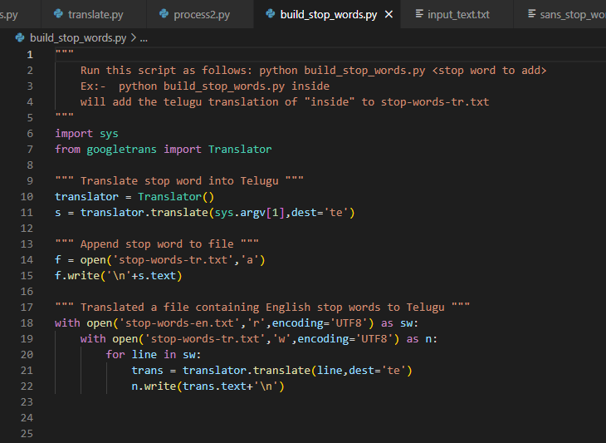
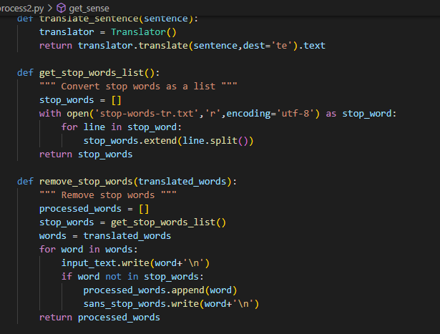
BbbvbbbhuBuild stop words Remove stop words

Slide 18
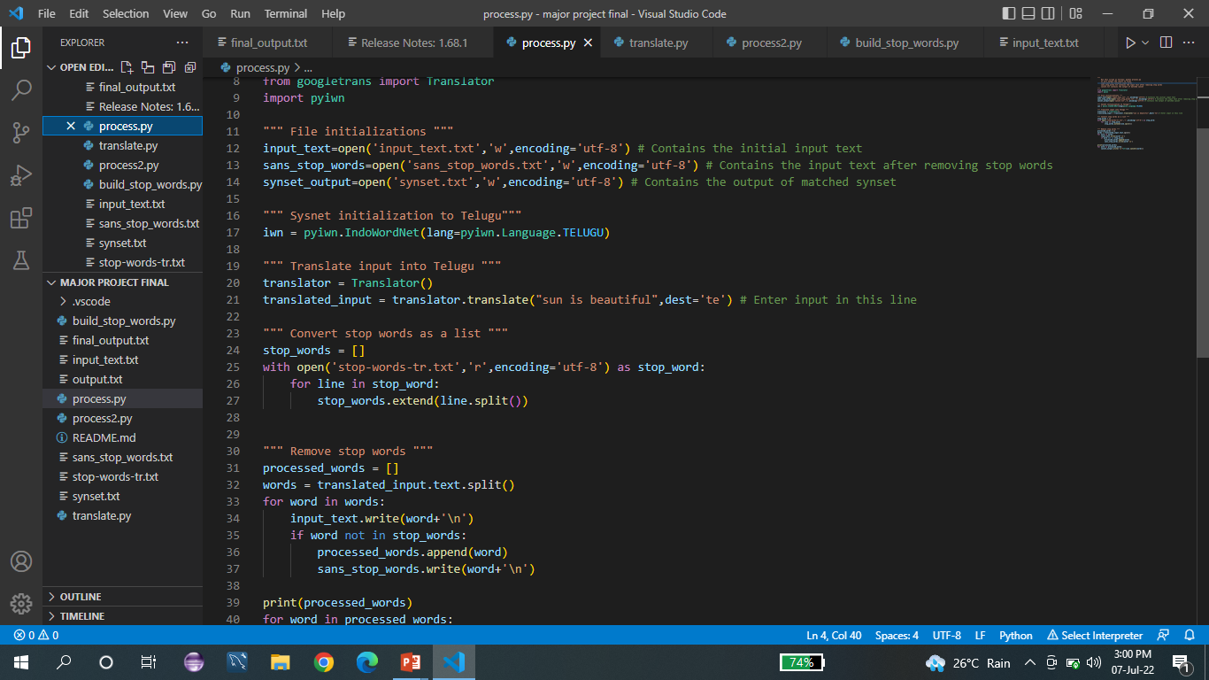

Slide 19
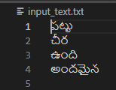
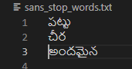
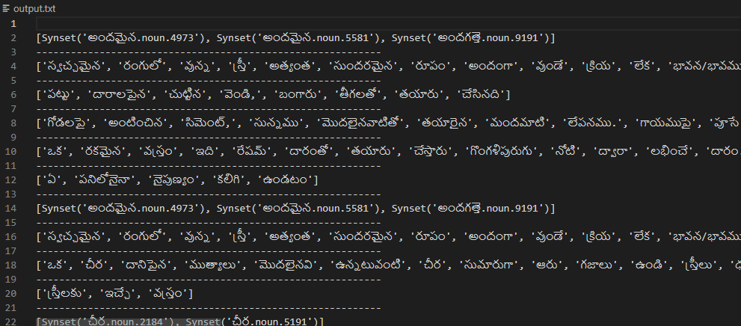
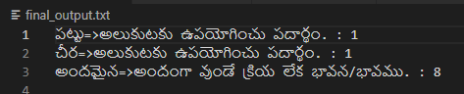
OUTPUT
In the below input sentences the word girp and silk have same translation ‘pattu’ in telugu but the meaning according to the context of sentence is different . So, In the output examples are given for each word in the context of the sentence.
Input text : Silk saree is beautiful
Fig : Input in telugu Fig : Input after removing stop words
Fig: Matching synset
Fig : Final output examples

Slide 20
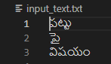
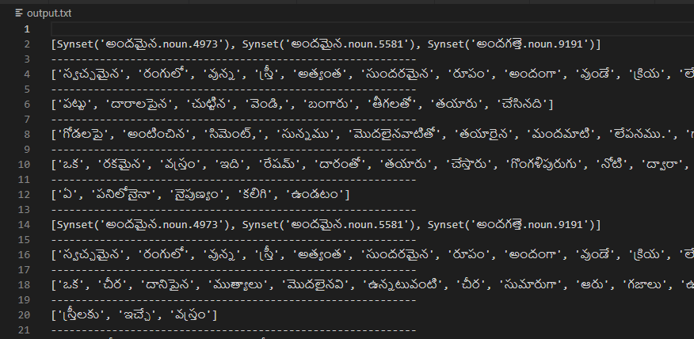
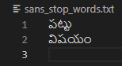
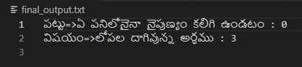
Input text : Grip on subject
Fig : Input in telugu Fig : Input after removing stop words
Fig : Final output examples
Fig: Matching synset

Slide 21
CONCLUSION
This paper mainly focuses on Semantic Disambiguation. Many approaches were made in solving them which mainly focused on English language. So, this paper focuses on Semantic distinguishing for Telugu which is an Indian regional language spoken by the people of states of Telangana and Andhra Pradesh. Semantic distinguishing to identify the context of a word in telugu sentences is achieved after performing necessary preprocessing steps such as translating the words, stop-words filtration, stemming, etc., and later implementing the Lesk algorithm on the processed words and outputs examples to understand the context of the sentences. This works for the input which is given in single sentences form.

Slide 22
REFERENCES
A. Brahmananda Reddy “Integrated Feature Selection Methods for Text Document Clustering”, Integrated Feature Selection Methods for Text Document Clustering, 2015.
A. Brahmananda Reddy, A.Govardan “Ontology for an Education System and Ontology Based Clustering”, The Fifth International Conference on Fuzzy and Neuro Computing (FANCCO - 2015), IDRBT, Hyderabad, 2015.
J.Sreedhar , Dr.S.Viswanadha Raju, Dr.A.Vinaya Babu “A Study of Critical Approaches in WSD for Telugu Language Nouns: Current State of the Art” International Journal of Scientific &Engineering Research, Volume 5, Issue 6, ISSN 2229-5518, June 2014
Christiane Fellbaum (1998, ed.) WordNet: An Electronic Lexical Database. Cambridge, MA: MIT Press.
George A. Miller (1995). WordNet: A Lexical Database for English Communications of the ACM Vol. 38, No. 11: 39-41.
Ritesh Panjwani, Diptesh Kanojia, Pushpak Bhattacharyya “pyiwn: A Pythonbased API to access Indian Language WordNets” IIT Bombay, 2018

Slide 23
ACKNOWLEGEMENT
We would like to thanks to our guide DR.M.V.Vijaya Saradhi, Head of the Department of Computer Science and Engineering, Ace Engineering College and Mrs. Soppari Kavitha for their continuous support and guidance. Due to their guidance, we could complete our work successfully.

Slide 24
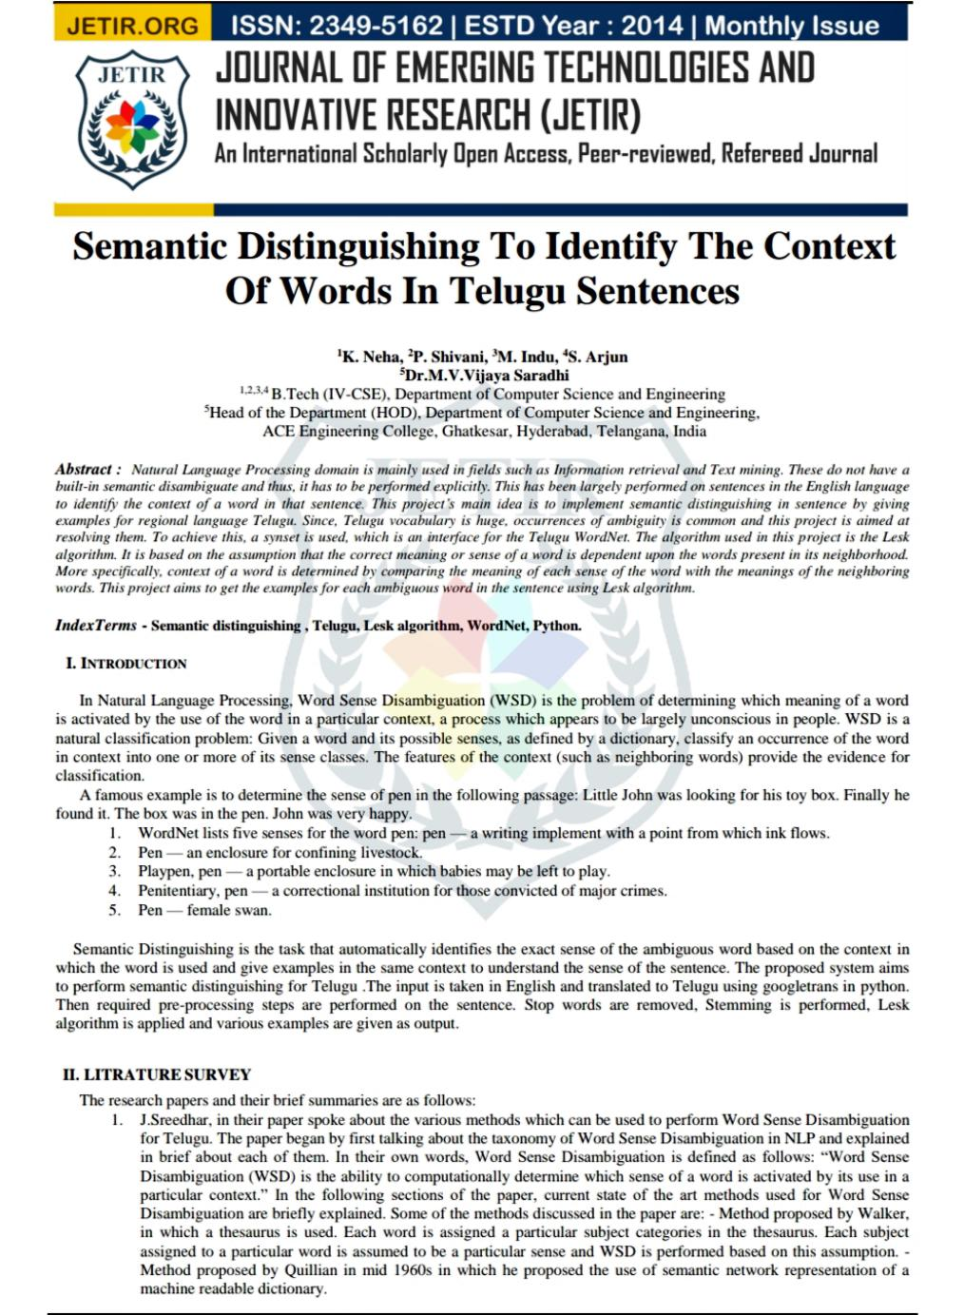

Slide 25
THANK YOU :)

